Slide 1
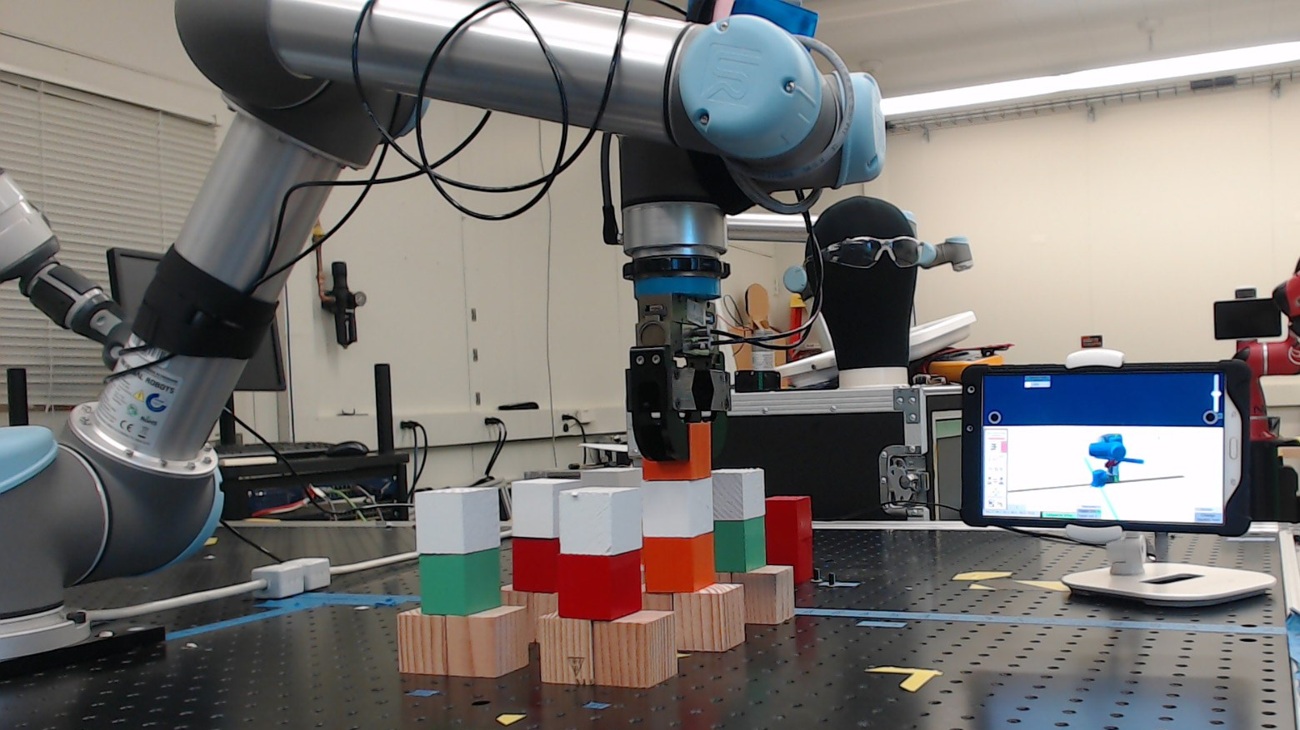
Adaptive Metrics and Performance Analysis Tool for Human-Robot Interaction
Author: Esteban Segarra Martinez;
Mentors: Shelly Bagchi, Dr. Jeremy Marvel, Megan Zimmerman

Slide 2
Introduction
Collaborative robots are robots that are safer to use with a task in collaboration with a human in a manufacturing task
When a user uses a robot, they use an industrial controller known as a human-machine interface (HMI)
NIST is interested in producing test methods to measure the interaction from using a robot, the human-robot interaction (HRI), from using a system from the perspective of a novice user
Figure 1 – Human-robot interaction
NIST Engineering Laboratory
Notes:
To begin off, we will start with understanding what is a collaborative robot. A collaborative robot or “co-robot” for short, is a robot that can be used in collaboration with a human worker or operator. A co-robot can have stronger carry capacity or similar benefit than a human worker, but is physically safer to use for a human operator due to force-limiting motors, environmental sensors, and other technology that helps keep an operator safe.
Alongside this technology, new innovations have been created that can help an operator use the robot to collaborate in a task for which a single human operator might find challenging to perform alone, such as lifting heavy parts or repetitive tasks. To perform these tasks, a worker or operator will interact with the robot using a Human-machine interface, or a controller.
NIST is concerned with producing measurements from the use of different HMI systems to determine factors that can influence the applicability of using them in certain situations. In specific, we are concerned with the interaction that a user is having while utilizing the robot, or human-robot interaction .

Slide 3
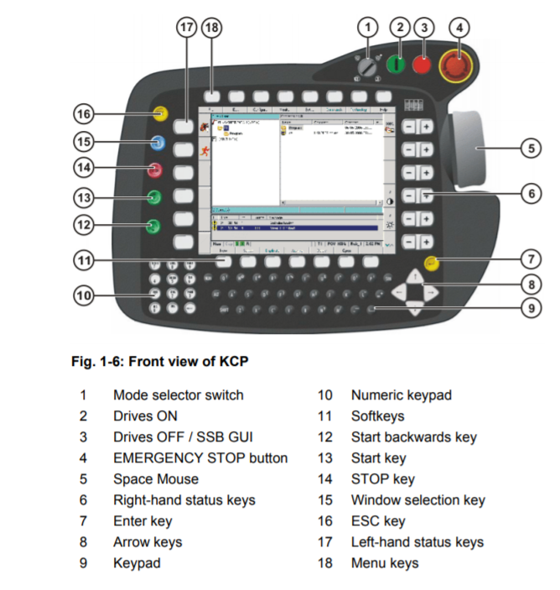
Background
HMI is the interaction point between a human and a robot
The design and features of a HMI determine how much time does a user require to learn to use a robot
Small and medium manufacturers are concerned with having low training times for robots that are going to be used by users with no prior experience with robots
Figure 2 – Example of an HMI industrial controller
NIST Engineering Laboratory
Notes:
The primary function of an HMI is to be able to interact with a robot or machine with an easy-to-understand controller. As shown on the right, this is a controller for a commonly used industrial robot known as the Kuka KCP2 industrial controller
As it can be shown, this type of controller has a high level of complexity for a novice user to use immediately, at the point when they first look at it they could be highly confused and would freak out at attempting to understand it. As such, training speed is slow and could take up to a month to understand, and could require additional training sessions to fully grasp the ability of using the controller.
As such, small and medium manufacturing enterprises in the United States are interested in being able to utilize their equipment with a lower training time than through conventional means especially since these robots will be utilized by novice or inexperienced individuals with an industrial robot. The target demography that an employer might hire would have an experience equivalent of high-school education or better.

Slide 4
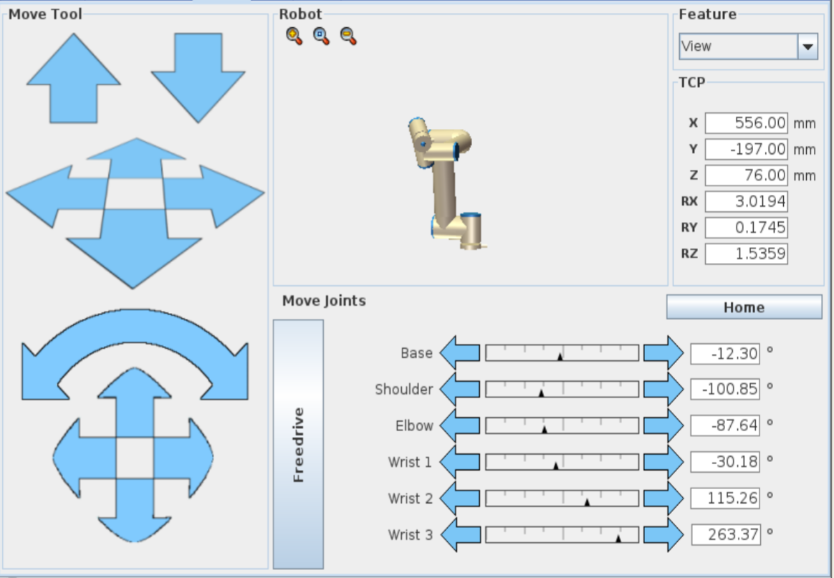
Figure 3 – Interface layout for an industrial robot
NIST Engineering Laboratory
Notes:
This is showcasing a controller for a modern industrial robot. As such, these robots can be fully controlled by the operator, however the ease of utilizing the controller for control is not as straight-forward for someone that has not had any experience with a robot. They could be confused by the large amount of dials or by the use of the virtual buttons.

Slide 5
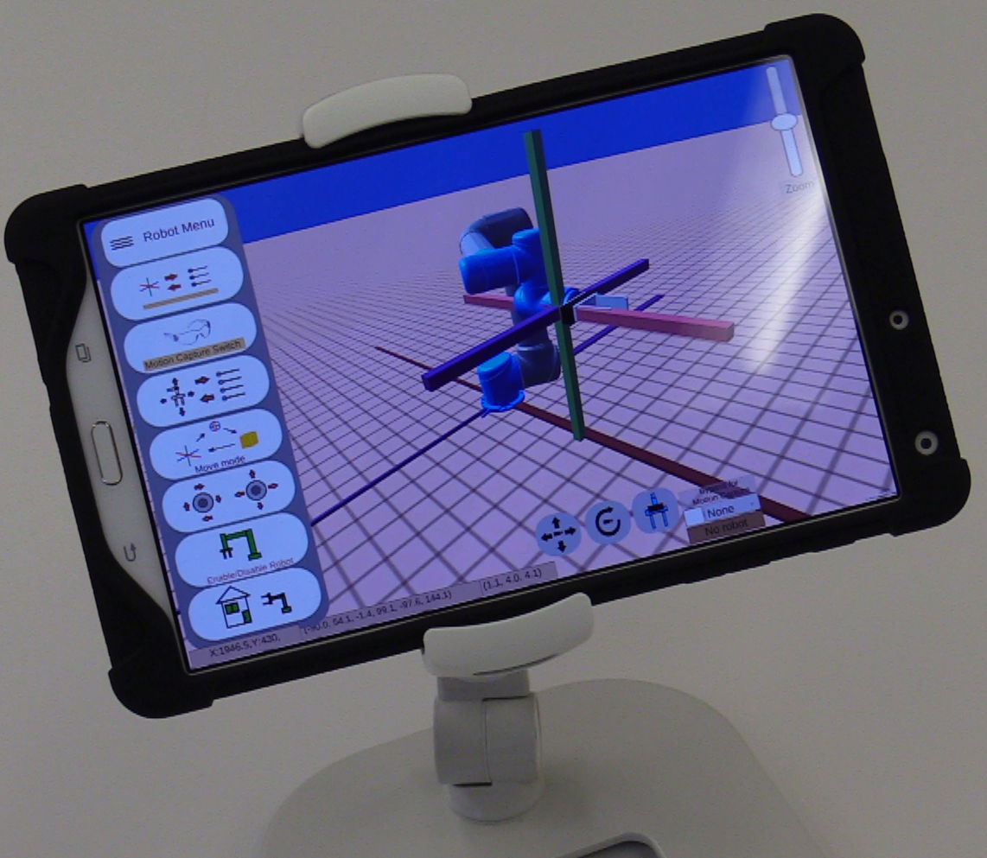
Objective
Recreate industrial controllers with different layouts and features in a user interfaces
Quantify the user experience while utilizing the user interface (UI)
Through application of an industrial case study, determine the performance between the application of different UI
Figure 4 – Controller interface
NIST Engineering Laboratory
Notes:
The primary goal of this project was to be able to re-create industrial controllers with the features they contain and be able to track the user’s actions as they use it. The controller will have similar functional features such as a regular industrial controller but the layout, feel, and features in the system will be different to those as in a traditional industrial controller.
Through this system, tracking of the user’s favorite features will be tracked such as touchscreen clicks, buttons pressed, or direction of axis of end-effector moved.
In the end, this system will be applied through a case study of an industrial task to simulate potential activities that can be associated with the controller.

Slide 6
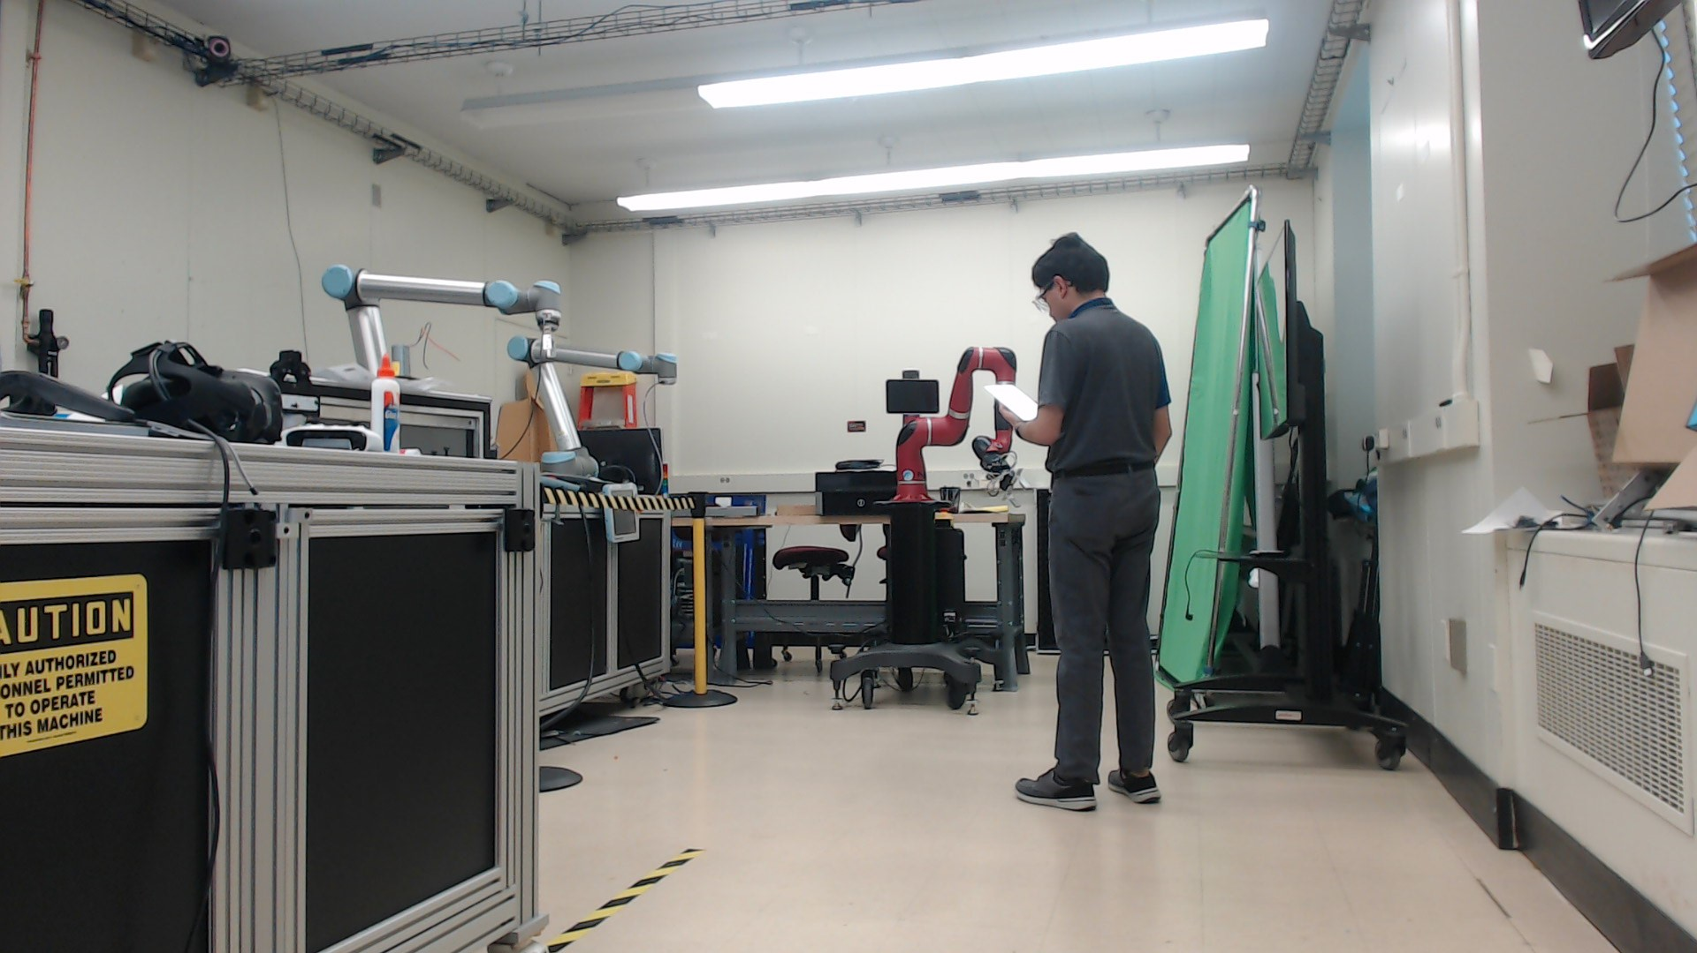
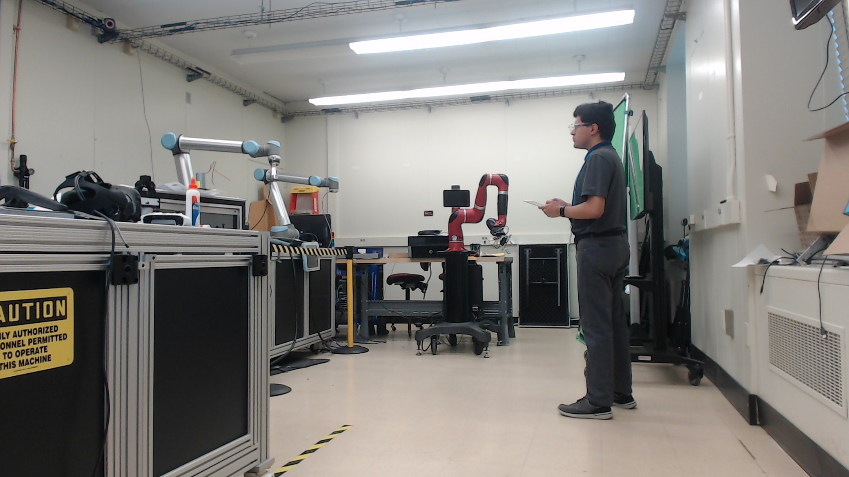
Methodology
What does the human want me to do?
Are my controls being acknowledged?
Figure 5 – A user asks if the robot is enabled
Figure 6 – A user requests feedback
NIST Engineering Laboratory
Notes:
In this case scenario, the user will be in a symbiotic feedback system where the robot is being informed of the user’s controls and the user is informed of the robot’s status. In this case, two case examples are shown, one where the user is requesting information from the robot’s status and the second scenario where the robot is acknowledging the user’s desired controls and sees the feedback on the controller and/or robot.

Slide 7
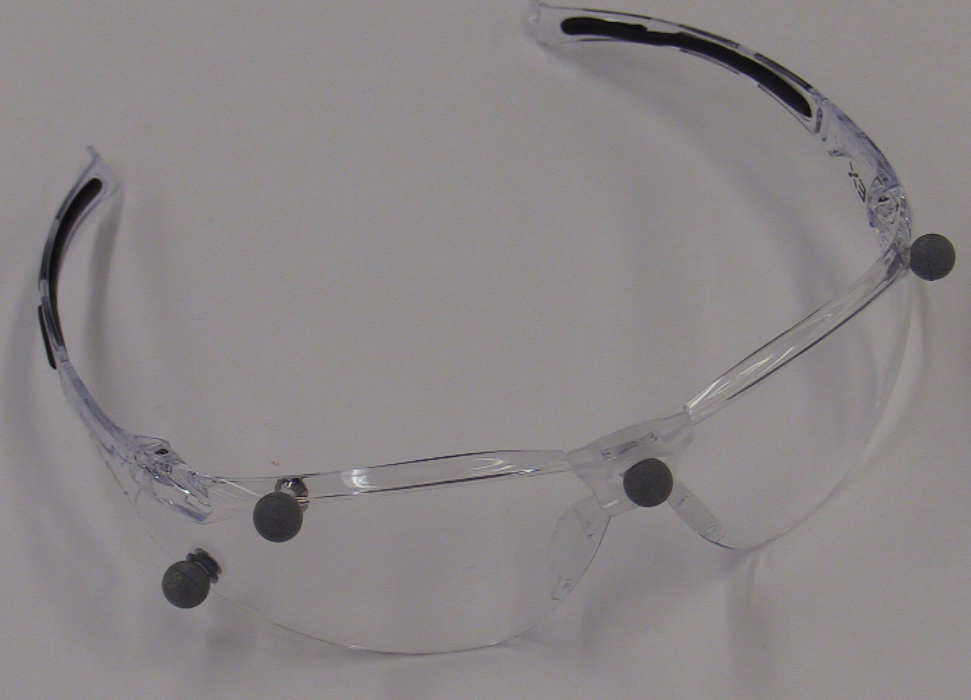
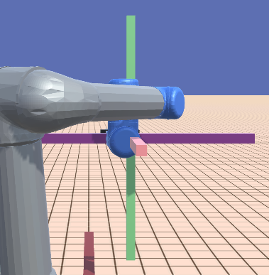
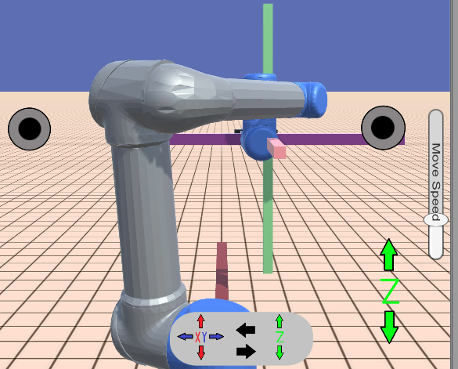
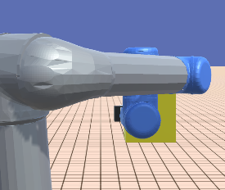
Methodology - Continued
Differences in layout, features, and design influence user experience
Changing the user experience can determine changes in the human-robot interaction
Figure 7 – Motion capture external controls
Figure 8 – XYZ control
Figure 9 – Joystick control
Figure 10 – Free-mode control
NIST Engineering Laboratory
Notes:
In order to provide the most flexibility of testing the controllers, several control systems were incorporated into the controller. These systems consist of three controller-specific controls such as XYZ control in the axis of direction and rotation. In addition the use of joystick controls were incorporated to study the different between using more common approaches to control. In the last control motion, free-mode was incorporated to move the end-effector in free-space.

Slide 8
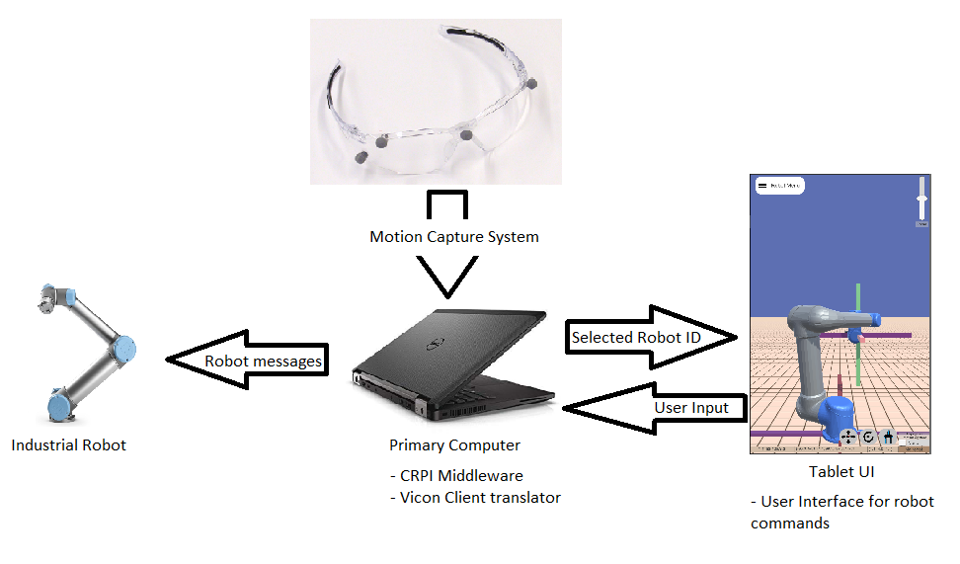
Setup
Figure 11 – System Overview breakdown
NIST Engineering Laboratory
Notes:
In this basic overview of the system there are four primary systems that are being used to compromise the whole system. This consists of the controller app being displayed on a tablet which sends all basic robot functionalities such as movement, gripper status, or digital-port I/O functions. A secondary system that is also active at the same time as the controller is the motion capture system that relys motion-capture information to a client on a middle-man computer. This middle-man computer acts a server and client from which data sent from the controller is translated directly to the robot utilizing a special library.

Slide 9
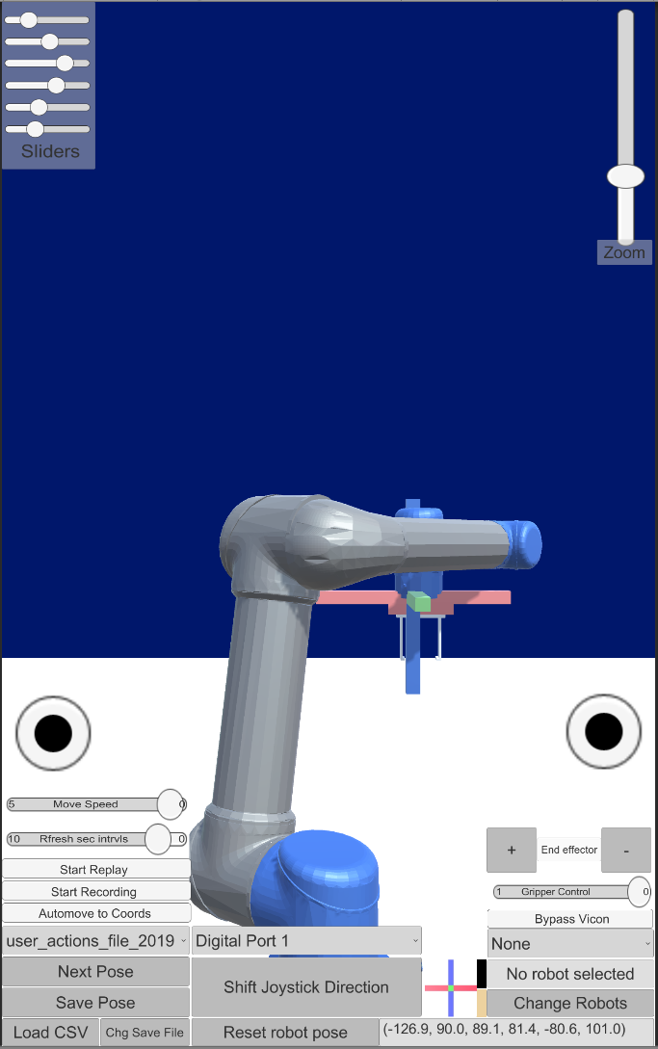
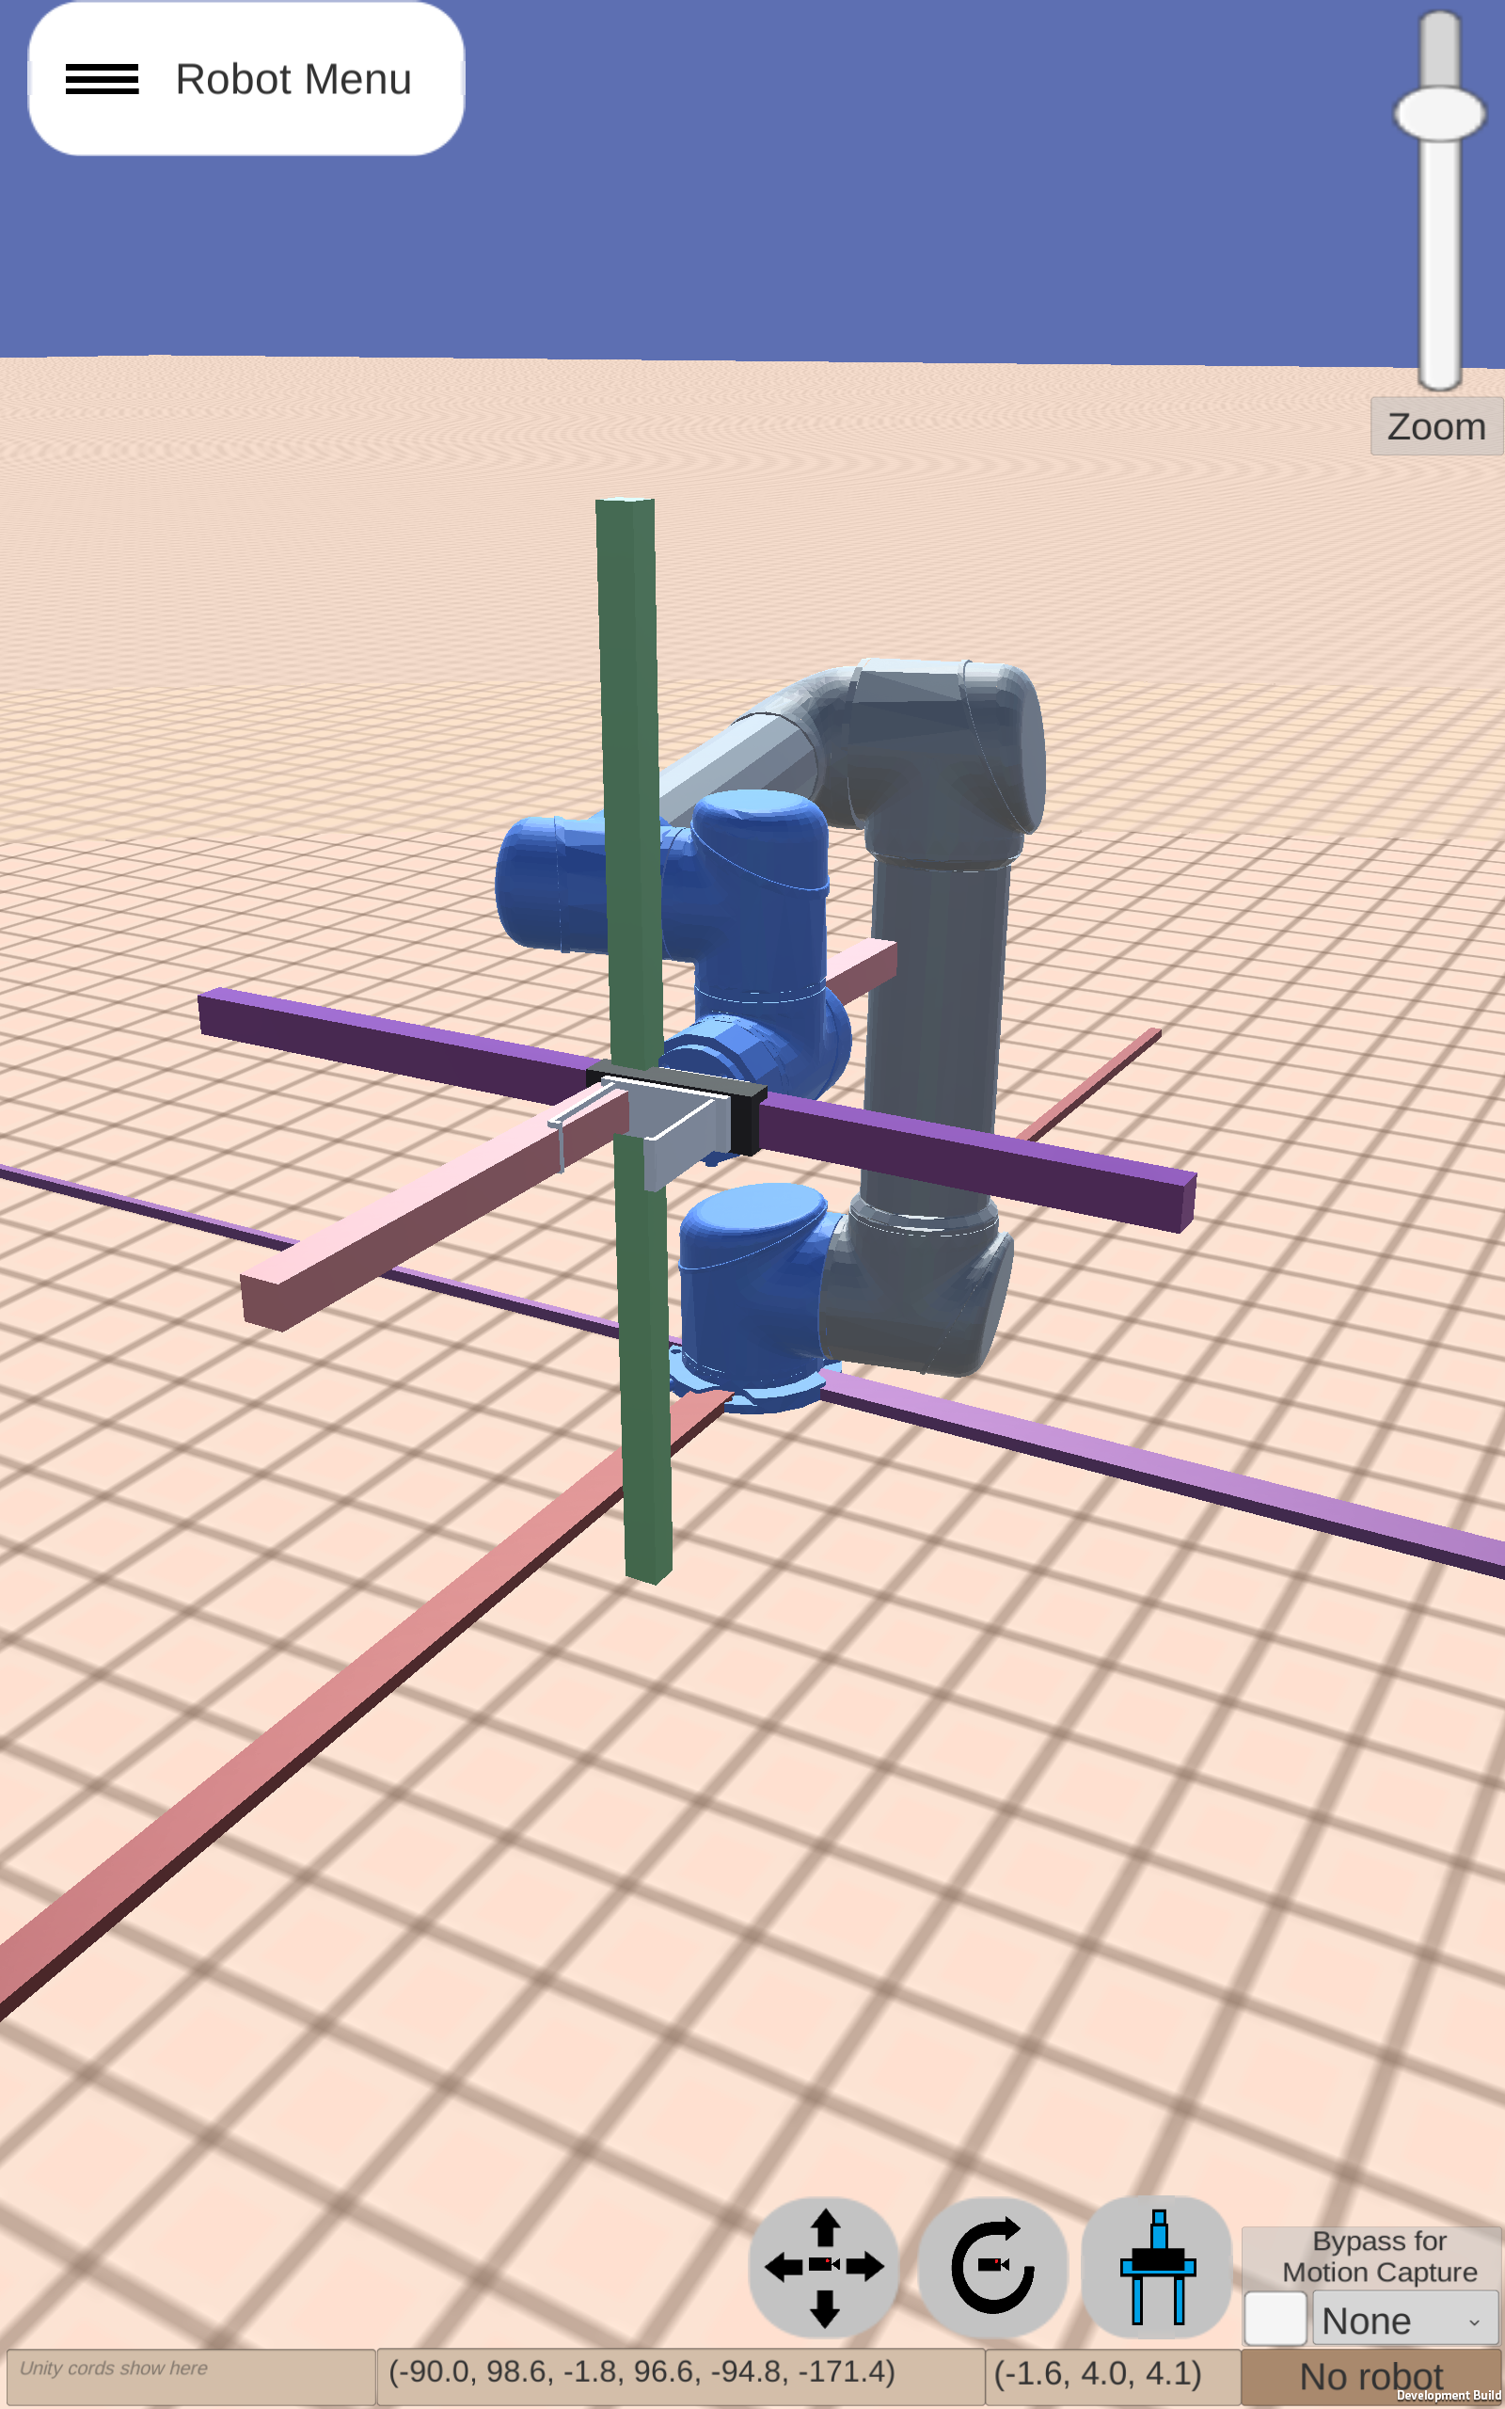
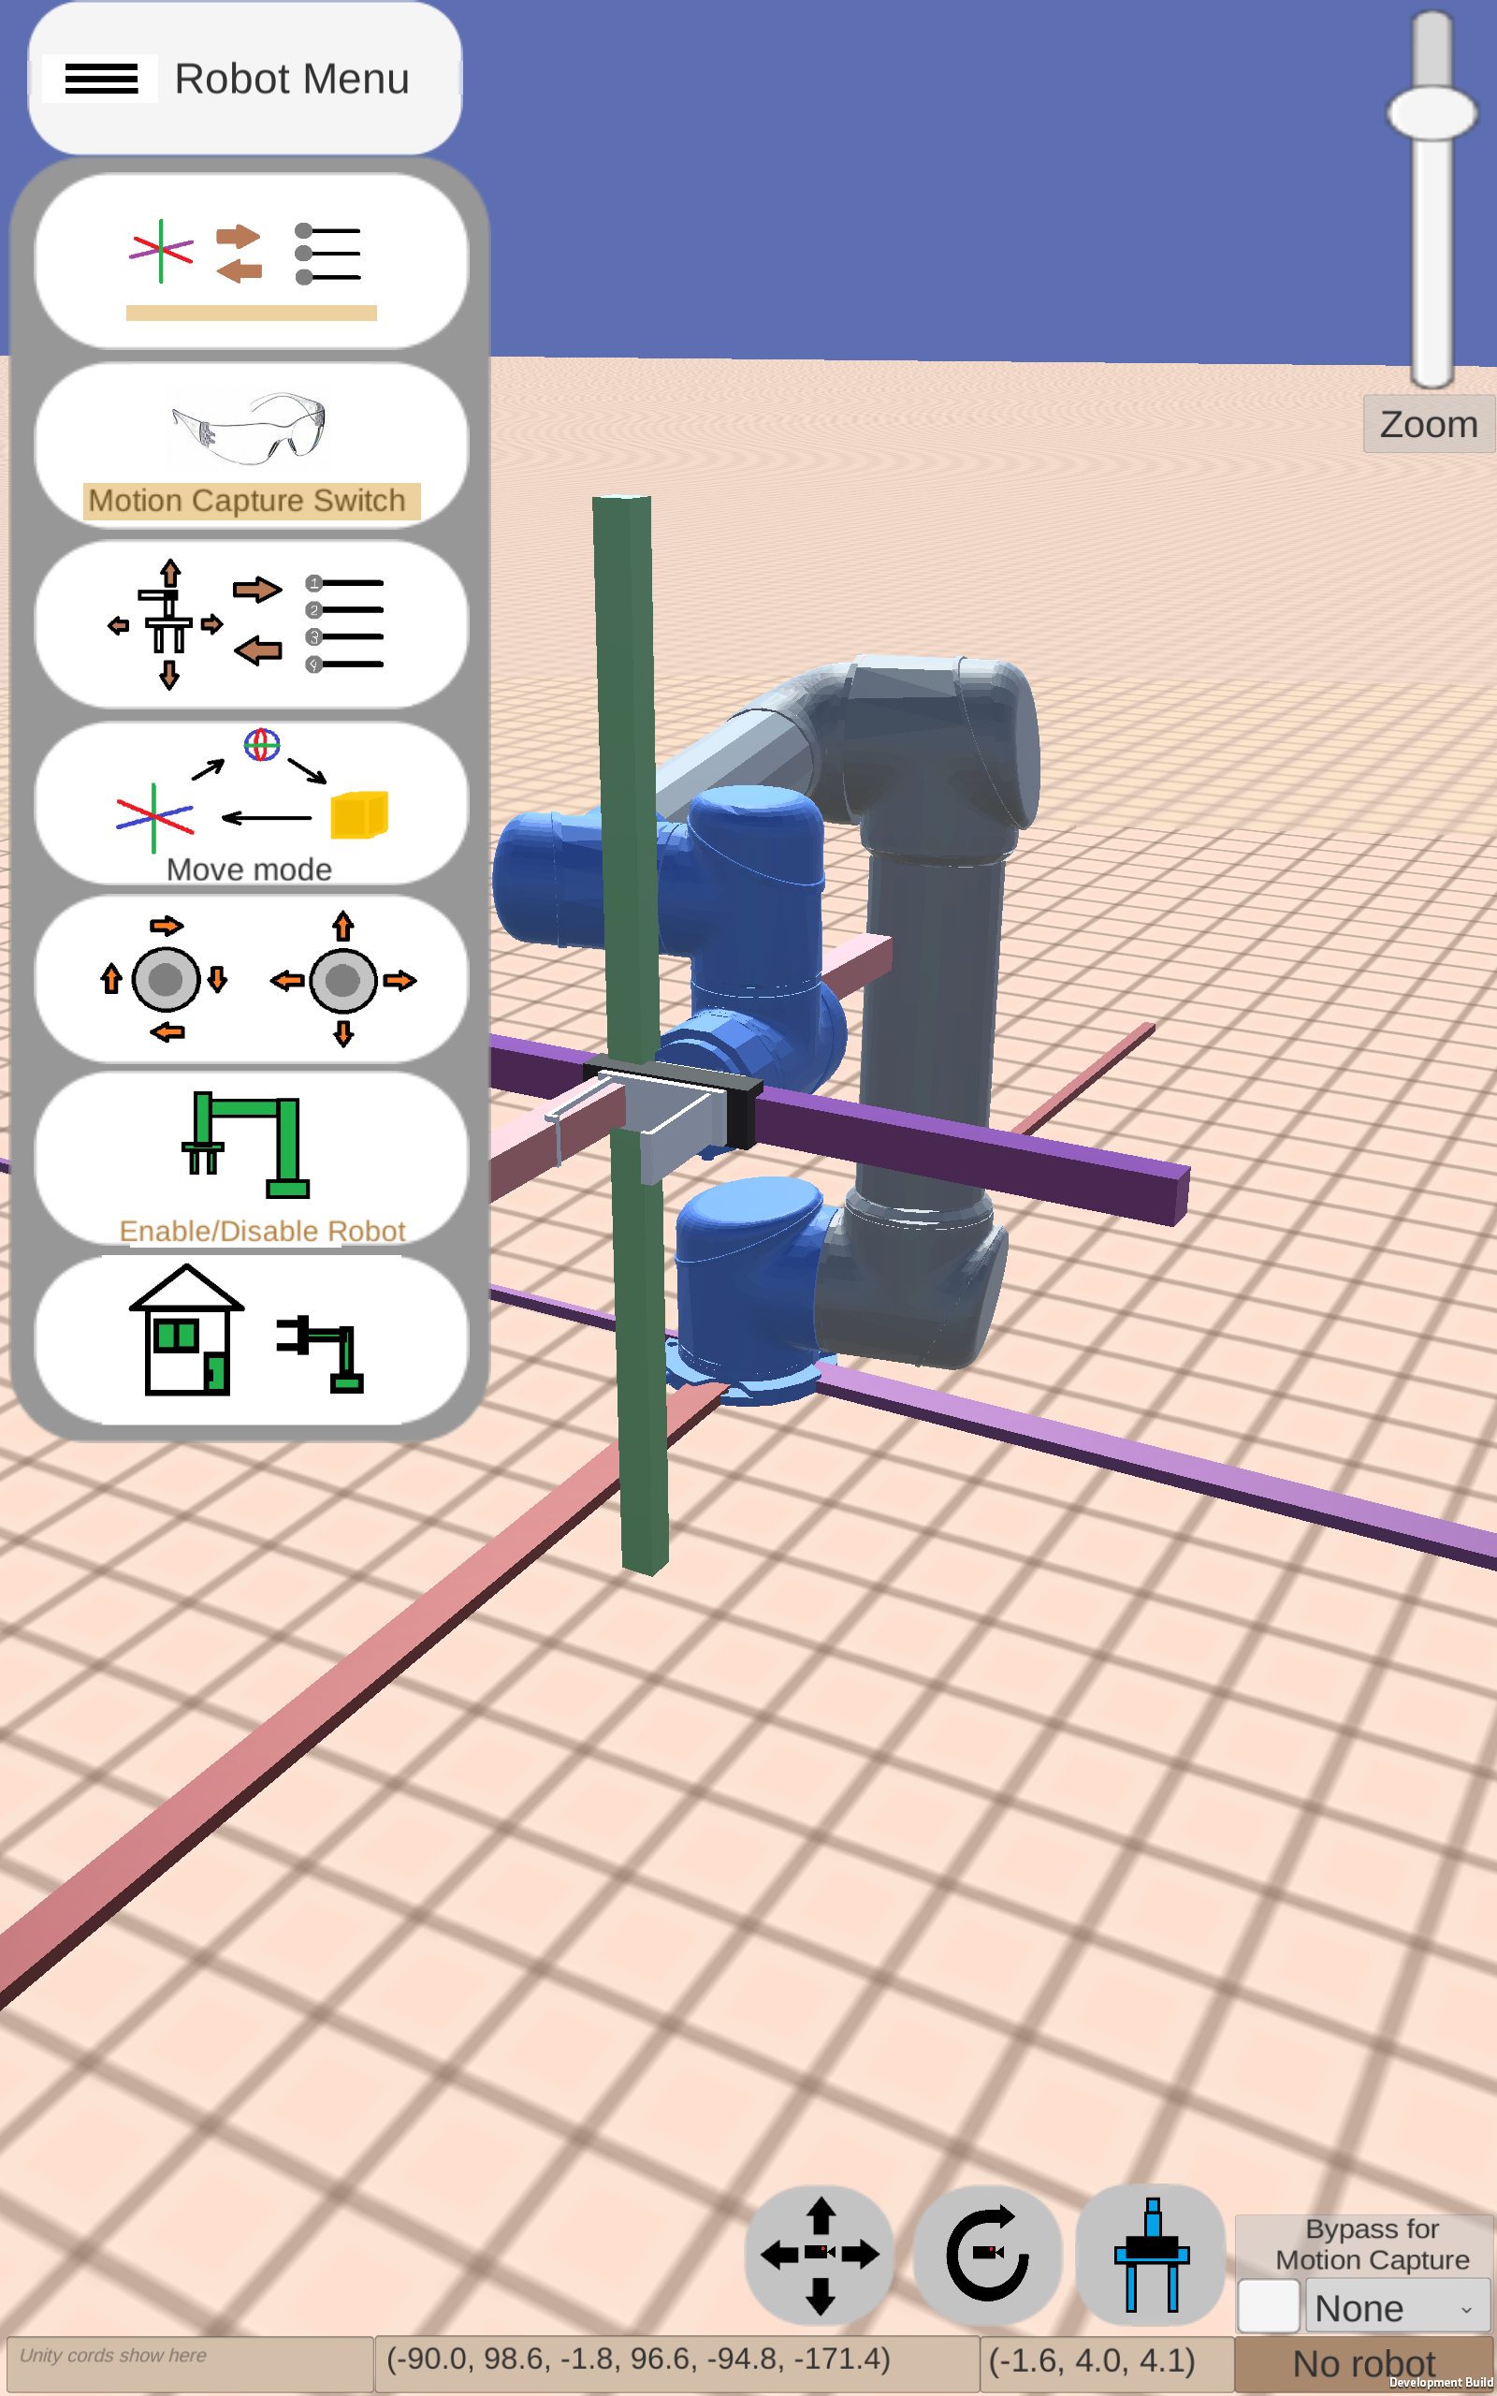
Figure 13 – Example of a first-generation interface
Figure 14 and 15 – Example of a Structured Interface
NIST Engineering Laboratory
Notes:
In this example you can see how the user interface is being utilized to simulate a complex/convoluted system in comparison to a more modern and less convoluted controller system. Through this clear-to-see example you can differentiate the difference of using different control schemes.

Slide 10
Video Demonstration
x8 Speed
NIST Engineering Laboratory
Notes:
In this video the user interface is actively being utilized to control the robot
The robot interface is being shown with the user pressing different buttons to achieve different control schemes to place the green blocks over the stacking points

Slide 11
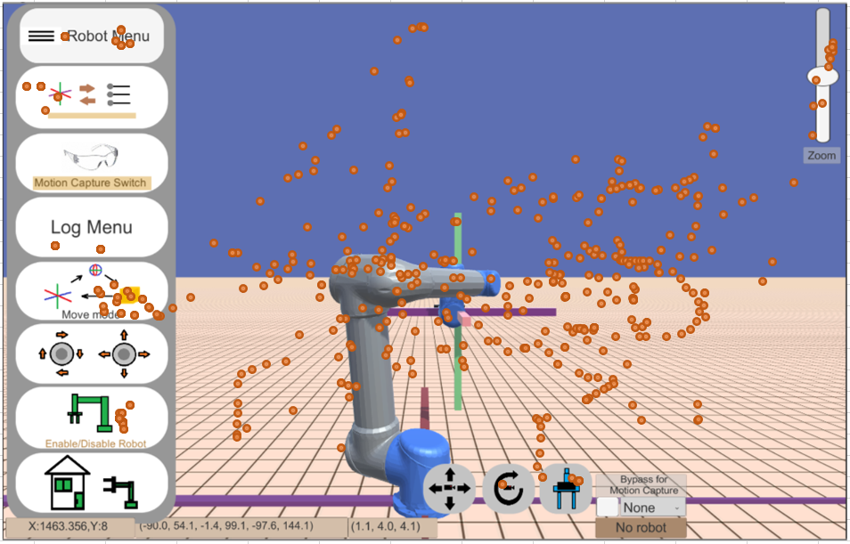
Results
Unity records motions perceived from the tablet such as the position of the touch and which buttons are being pressed
The layout can be changed around as desired with different tasks being applied
Figure 12 – Touchscreen heatmap from user
NIST Engineering Laboratory

Slide 12
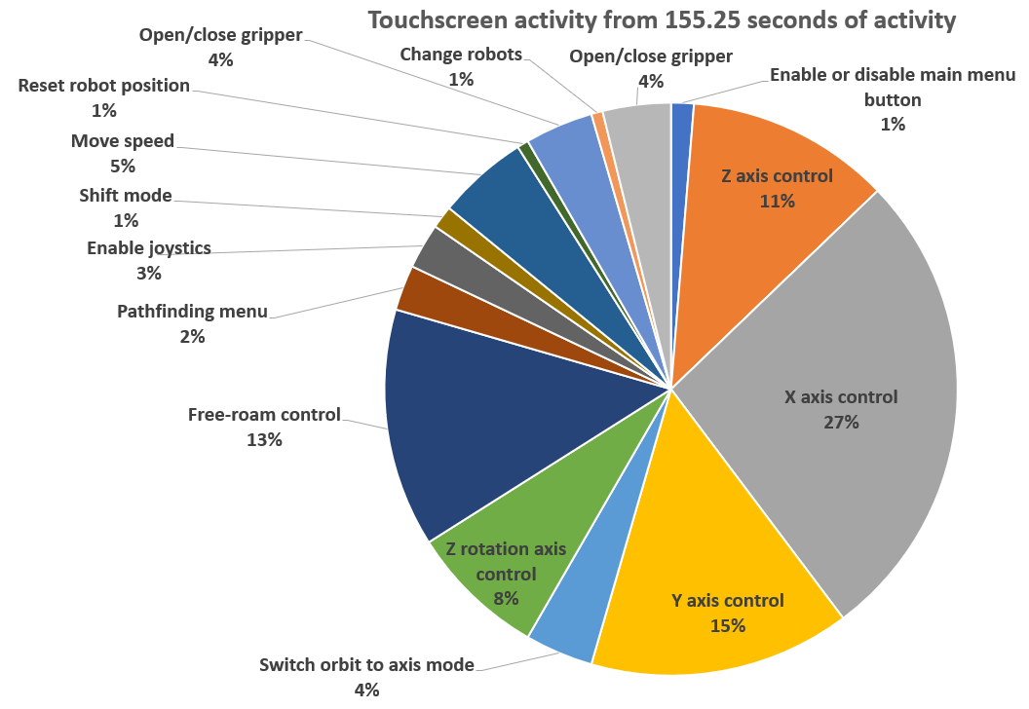
Figure 16 – Touchscreen activity from user in a trial
NIST Engineering Laboratory
Notes:
In this trial case, we were observing the touchscreen clicks and movement from a user using the system.

Slide 13
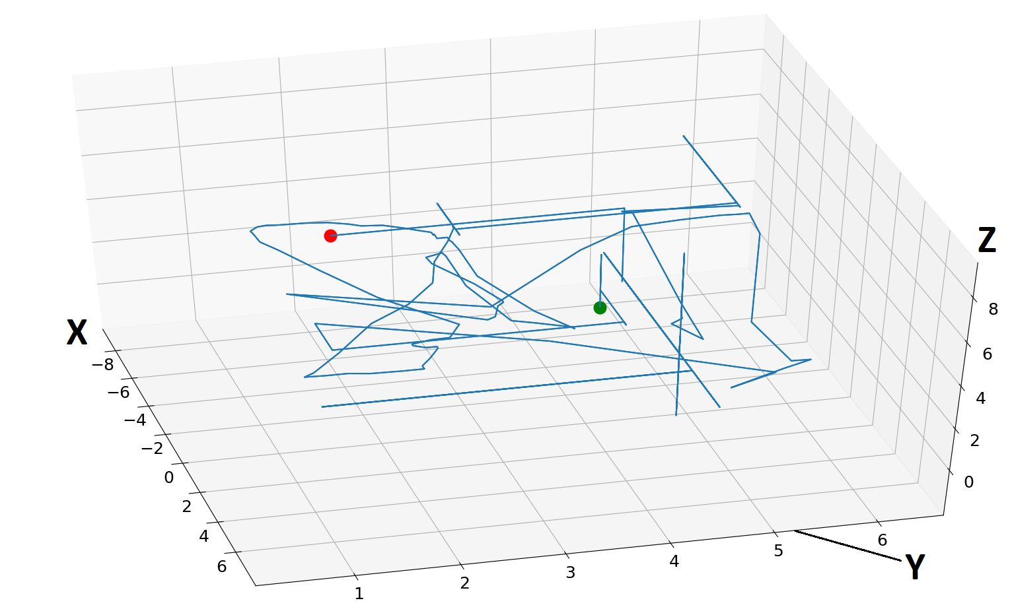
End
Start
Figure 17 – 3D map of end-effector movement as used by the user during a trial.
Notes:
In this overview of a trial you can see the different places a user moved the end-effector or the end-piece of the robot while using it.

Slide 14
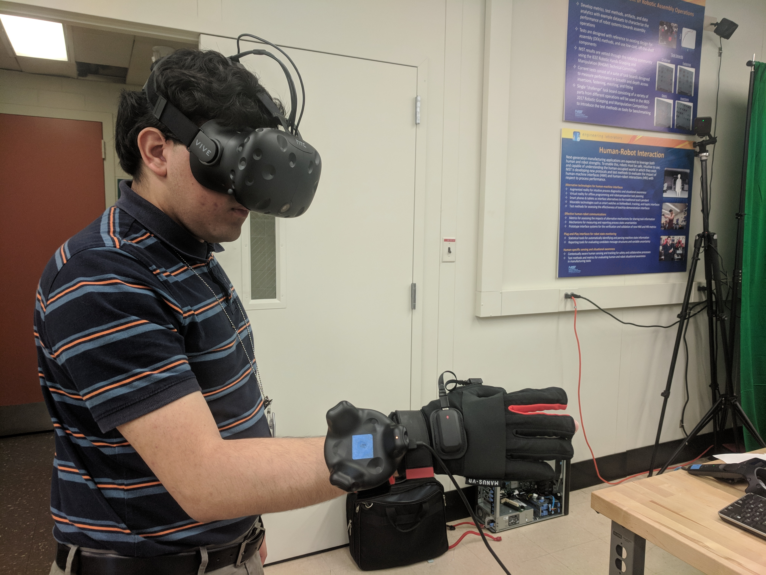
Conclusion and Future Work
Human trials of currently developed HMI to compare performance
Different layouts and control schemes are going to be used for this
The studies will analyze state-of-the art technologies such as virtual reality, augmented reality, or wearable technologies
Figure 18 – Examples of future testing equipment including virtual reality and wearable technology
NIST Engineering Laboratory
Notes:
In conclusion, the project will be part of a series of human trials that will be looking a different types of HMI systems and studying their impact on ease of use of a robot.
For the application of our system in these case studies, we will be looking at how effective they are at different layouts of the controls, the ease of viewing them under different circumstances, and the ability of the system to convey accurate feedback to the user using the system.
Different technologies will be studied in this case and will consist of means to studying if they will be best to apply in certain manufacturing cases or not and receive feedback from users regarding the different types of systems in use.

Slide 15
Questions?
Special thanks to:
Jeremy Marvel
Shelly Bagchi
Megan Zimmerman
Project Files are available on GitHub
https://github.com/usnistgov/CRPI
https://github.com/OvercodedStack/ANDROID_UNITY_UI-Summer-2019-NIST/tree/Android-Branch
https://github.com/OvercodedStack/MOTION_CAPTURE_UNITY-Summer-of-2019-NIST
https://github.com/OvercodedStack/CRPI_MIDDLEWARE_INTEGRATION-Summer-of-2019-NIST
https://github.com/OvercodedStack/CRPI-UI-DOCUMENTATION-Summer-of-2019
Thank you for NIST SURF 2019!

Slide 16
NIST Disclaimer
Certain commercial equipment, instruments, or materials are identified in this paper to foster understanding. Such identification does not imply recommendation or endorsement by the National Institute of Standards and Technology, nor does it imply that the materials or equipment identified are necessarily the best available for the purpose.
NIST Engineering Laboratory

Slide 17
References for Images
Amazon.com for image for Latitude E5570
Universal Robotics for UR5 image
NIST Engineering Laboratory

Slide 18
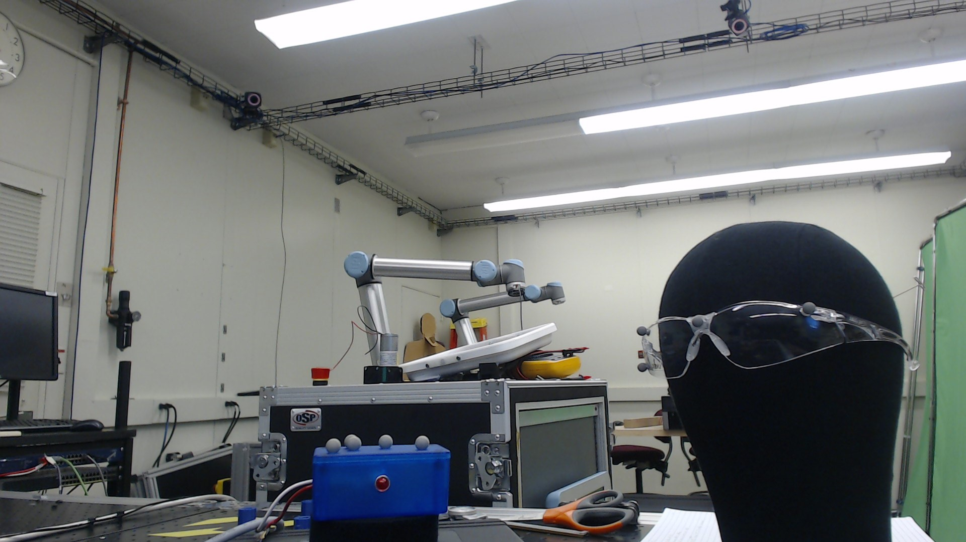
Motion Capture Setup
Motion Capture System
Motion Capture Objects
Figure 19 – Motion capture parts
NIST Engineering Laboratory

